Slide 1
A study of Machine Learning Algorithms for Automated Essay Grading

Slide 2
Outlines
Introduction
Machine learning
Workflow
Preprocessing
Produce TF-IDF matrix
Singular value decomposition
Machine Learning Algorithms
Results

Slide 3
Introduction
Automated essay grading is the task of predicting the score of an essay so
that the score might seem like it has come from a human reader. Aim of this
paper is to examine the possibility of developing such automated essay
grader .To this end different natural language processing techniques and
machine learning algorithms have been studied. As essay data set 1800
essays form Hewlett foundation available in Kaggle ,have been used. At first
different natural language processing techniques and tools have been used to
process those essays. Then noticeable tf-idf features are extracted to train
different supervised machine learning algorithms to build an artificial system
that could score further user given essays.

Slide 4
Machine Learning
Instead of writing programs that explain to computers how to
perform specific task, in machine learning, programmers write
algorithms that explain computers how to learn by themselves to
perform tasks. Machine Learning algorithms is a computer
program that teaches computers how to program themselves

Slide 5
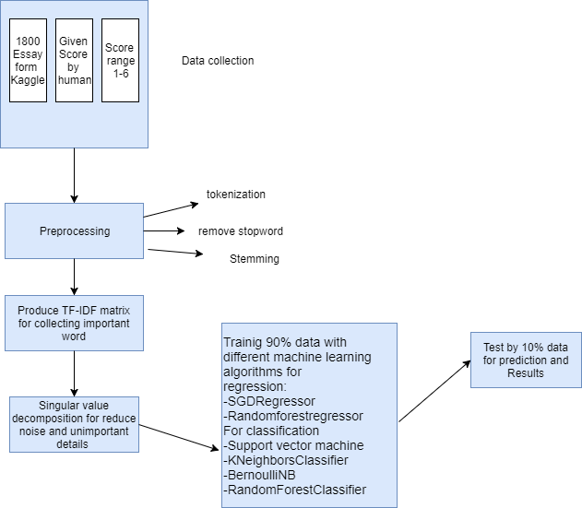
Workflow
In this slide I am going to show in brief what I have done

Slide 6
Preprocessing
i.tokenization: It is a processing of converting a large text into single pieces of tokens. I use python NLTK’s word Tokenize for tokenization.
nltk.word_tokenize(string)
Ex: I am a student .
After tokenize: I, am, a, student,.
ii.remove stopword:
A collection of words that is mostly present in each and every texts and that are mostly useless in natural language processing research.
In fact removing those gives better result. These lists contains words like a, an, the etc. And also the punctuations like brackets and other symbols.
from nltk.corpus import stopwords
stop_words = set(stopwords.words('english'))
iii.stemming:
transform the word to its base form or the stem form. For example “am, is, are” all of these can be transformed into base word “be”. Car, cars, car’s, etc. can be traced down to car python nltk has a build in support for porter algorithm .
from nltk.stem.porter import PorterStemmer

Slide 7
Produce Tf-idf matrix
Tf-idf stands for term frequency-inverse document frequency
TF: Term Frequency, which measures how frequently a term occurs in a document.
TF(t) = (Number of times term t appears in a document) / (Total number of terms in the document).
IDF: Inverse Document Frequency, which measures how important a term is.
IDF(t) = log_e(Total number of documents / Number of documents with term t in it).
TF-IDF = TF*IDF
Producing importance of word by weighting with TF-IDF value of every word
For producing tf-idf matrix python scikit-learn has TfidfVectorizer .
from sklearn.feature_extraction.text import TfidfVectorizer

Slide 8
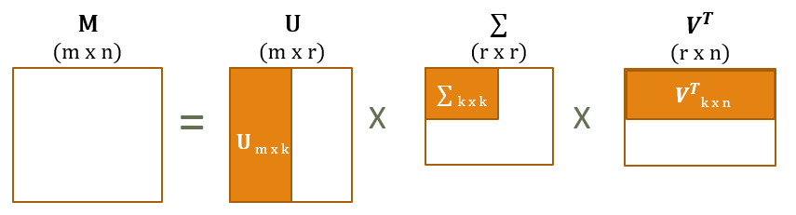
Singular value decomposition
The singular value decomposition of a matrix M is the factorization of M into the product of three matrices
The dimensionality reduction operation has been done by removing one or more smallest singular values from
singular matrix S and also deleted the same number of columns and rows from U and V, respectively. The purpose of
the dimensionality reduction is to reduce the noise and unimportant details.
Python Nympy has svd module .
U, s, V = numpy.linalg.svd(M ,full_matrices=False)

Slide 9
Machine Learning Algorithms
Regression model:
- SGDRregression
-Random forestregressor
Classification model:
- Support Vector Machine
- KNeighborsClassifier
- Bernoulli Naive Bayes
-RandomforestClassifier

Slide 10
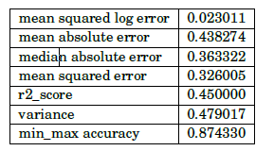
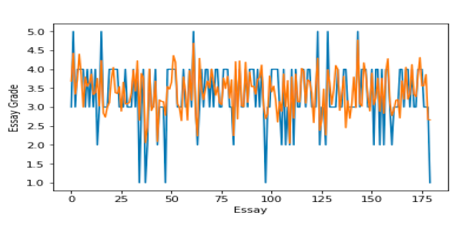
Results
Result of SGDRegressor

Slide 11
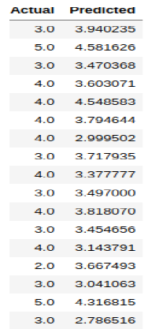
Result
Screen shot of Actual and predicted value of SGDRegressor

Slide 12
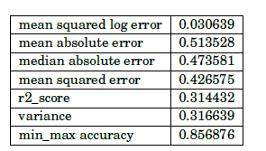
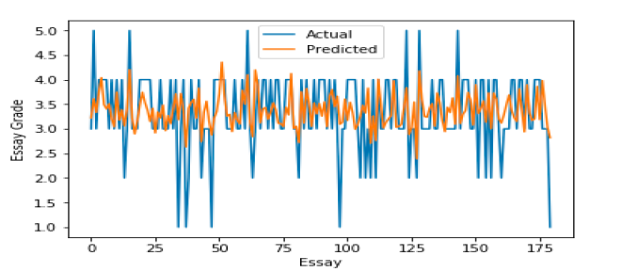
Results
Results of Randomforestregressor

Slide 13
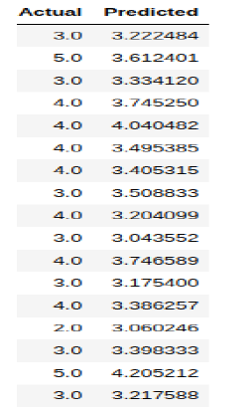
Results
Screen shot of Actual and predicted value of Randomforestregressor

Slide 14
Result
SGDRegressor Randomforestregressor
From above two table SGDRegressor is best

Slide 15
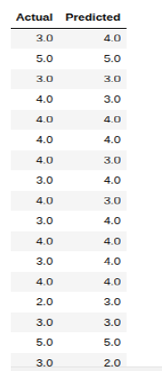
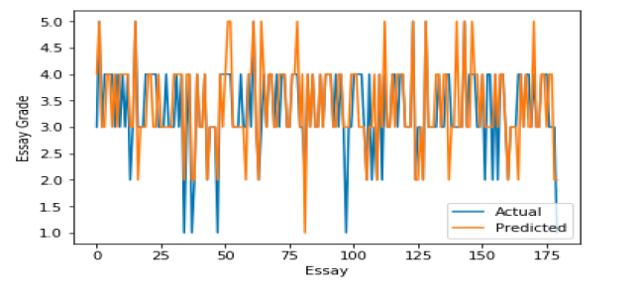
Result
Naïve Bays Classifier

Slide 16
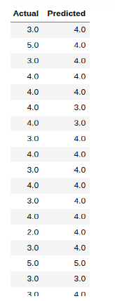
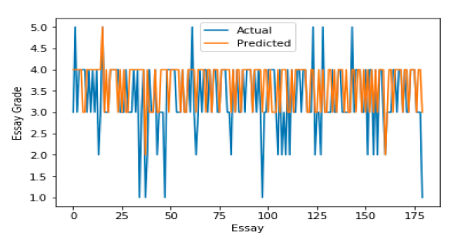
Results
KNeighborsClassifier:

Slide 17
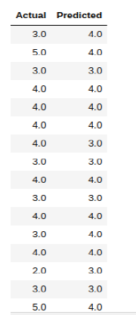
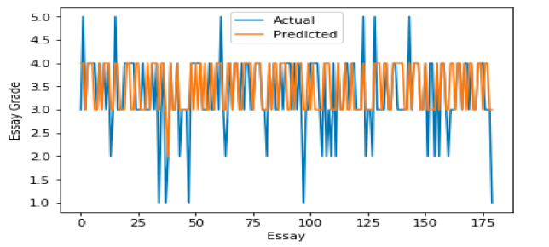
Results
RandomForestClassifier:

Slide 18
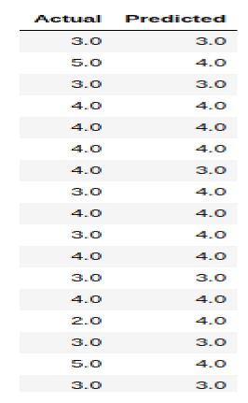
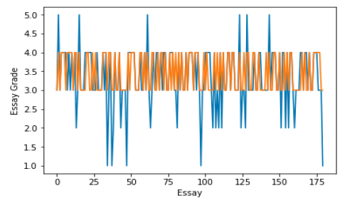
Results
Support Vector Machine:

Slide 19
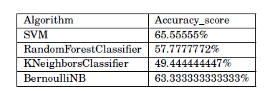
Results
Classification algorithms analyze with accuracy_score
Above from the table Support Vector Machine and Naïve Bayes Classifier is best.

Slide 20
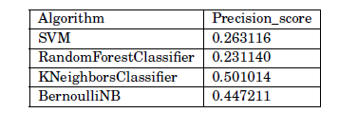
Results
Classification algorithms analyze with precision score:
From the above table KNeighborsClassifier is better than other

Slide 21
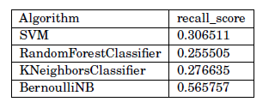
Results
Classification algorithms analyze with recall_score:
From the above table BernoulliNB is better than oter algorithms

Slide 22
Results
Classification algorithms analyze both accuracy_score and precision_score :
From both above table BernoulliNB is better than other algorithm

Slide 23
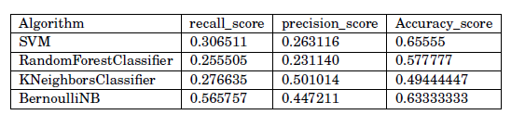
Results
Analyze all score for classification algorithms:
From the above table average score of BernoulliNB is higher than other
So BernoulliNB is better than oter classification algorithms

Slide 24
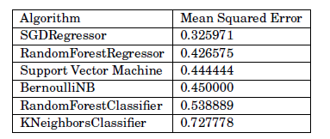
Results
Analyze with all Regression and Classification algorithms with mean_squared_error:
From the above table SGDRegressor is better than other

